Slide 1


Capstone Project Phase I
REVIEW I
PROJECT TITLE
Domain
TEAM MEMBERS :
Supervisor Name
INDUSTRY NAME
KPR Institute of Engineering and Technology, Coimbatore, Tamil Nadu, India
1

Slide 2
CONTENT
KPR Institute of Engineering and Technology, Coimbatore, Tamil Nadu, India
2

Slide 3
ABSTRACT
Design an IoT-based lavatory automation system to enhance efficiency, user comfort, and sustainability.
Provide real-time monitoring and control of key features like temperature, lighting, and air quality.
Develop a mobile application for remote control and notifications.
KPR Institute of Engineering and Technology, Coimbatore, Tamil Nadu, India
3

Slide 4
INTRODUCTION
Traditional lavatories in public or commercial buildings often rely on manual control systems, which are inefficient and prone to human error.
Lights and fans are often left running unnecessarily, leading to increased energy consumption.
Poor air quality due to lack of ventilation can negatively impact users, and delayed maintenance often results in equipment breakdowns.
As the use of smart technology becomes more prevalent, the need for automated lavatory systems has increased to provide better management, comfort, and operational efficiency.
KPR Institute of Engineering and Technology, Coimbatore, Tamil Nadu, India
4

Slide 5
LITERATURE REVIEW
(4 -6 slides)
KPR Institute of Engineering and Technology, Coimbatore, Tamil Nadu, India
5

Slide 6
PROBLEM IDENTIFICATION
Energy Wastage: Lights and fans are often left on even when the lavatory is unoccupied, leading to unnecessary electricity consumption.
Lack of Occupancy Tracking: Without a people counting system, lavatories can become overcrowded, and cleaning schedules aren’t optimized based on usage.
Inconsistent Air Quality: Poor ventilation can lead to the build-up of unpleasant odors and potentially harmful gases, creating a suboptimal environment.
Manual Maintenance: Faulty equipment, such as broken lights or malfunctioning fans, is often reported late, leading to extended downtimes and user dissatisfaction.
KPR Institute of Engineering and Technology, Coimbatore, Tamil Nadu, India
6

Slide 7
METHODOLOGY
Uses temperature sensors to automatically control the fan based on room temperature.
Activates lights using motion sensors when people enter, and turns them off when they leave.
Adjusts light brightness depending on the ambient light to save energy.
Tracks the number of people entering and exiting the lavatory using IR sensors for occupancy management.
Monitors air quality and triggers ventilation when needed using air quality sensors.
Sends maintenance notifications automatically when issues are detected, such as poor air quality or system malfunctions.
7
KPR Institute of Engineering and Technology, Coimbatore, Tamil Nadu, India

Slide 8
BLOCK DIAGRAM
8
KPR Institute of Engineering and Technology, Coimbatore, Tamil Nadu, India

Slide 9
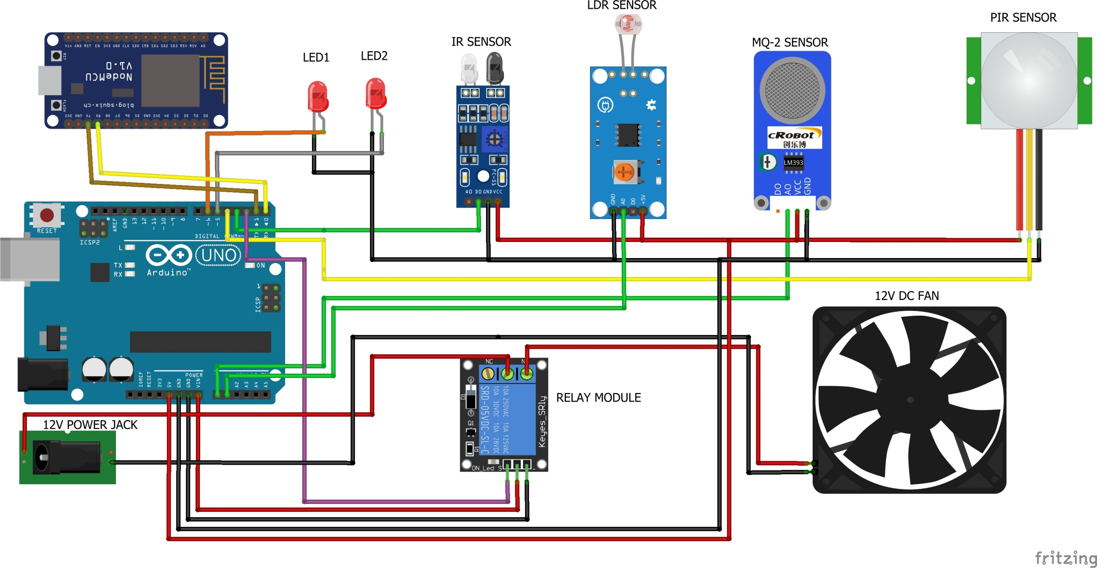
CIRCUIT DIAGRAM
9
KPR Institute of Engineering and Technology, Coimbatore, Tamil Nadu, India

Slide 10
SIMULATION / EXPERIMENTAL SETUP
10
KPR Institute of Engineering and Technology, Coimbatore, Tamil Nadu, India

Slide 11
RESULTS AND DISCUSSION
The implementation of the IoT-based Lavatory Automation System led to improved energy efficiency by automatically controlling fan and light usage based on occupancy and ambient conditions, resulting in significant electricity savings.
Enhanced user comfort was achieved through real-time monitoring of temperature and air quality, creating a more pleasant environment for lavatory users.
The people counting feature enabled efficient management of cleaning schedules.
Automatic notifications for maintenance issues.
11
KPR Institute of Engineering and Technology, Coimbatore, Tamil Nadu, India

Slide 12
REFERENCES
12
KPR Institute of Engineering and Technology, Coimbatore, Tamil Nadu, India

Slide 13
KPR Institute of Engineering and Technology, Coimbatore, Tamil Nadu, India
12

